Slide 1
Introducing Inferential Statistics:
ANOVA
(Analysis of Variation)

Slide 2
Analysis of Variance
The Analysis of Variance is abbreviated as ANOVA
Used for hypothesis testing in
  Simple Regression
  Multiple Regression
  Comparison of Means

Slide 3
Sources
There is variation anytime that all of the data values are not identical
This variation can come from different sources such as the model or the factor
There is always the left-over variation that can’t be explained by any of the other sources. This source is called the error

Slide 4
Variation
Variation is the sum of squares of the deviations of the values from the mean of those values
As long as the values are not identical, there will be variation
Abbreviated as SS for Sum of Squares

Slide 5
Degrees of Freedom
The degrees of freedom are the number of values that are free to vary once certain parameters have been established
Usually, this is one less than the sample size, but in general, it’s the number of values minus the number of parameters being estimated
Abbreviated as df

Slide 6
Variance
The sample variance is the average squared deviation from the mean
Found by dividing the variation by the degrees of freedom
Variance = Variation / df
Abbreviated as MS for Mean of the Squares
MS = SS / df

Slide 7
F
F is the F test statistic
There will be an F test statistic for each source except for the error and total
F is the ratio of two sample variances
The MS column contains variances
The F test statistic for each source is the MS for that row divided by the MS of the error row

Slide 8
F
F requires a pair of degrees of freedom, one for the numerator and one for the denominator
The numerator df is the df for the source
The denominator df is the df for the error row
F is always a right tail test

Slide 9
The ANOVA Table
The ANOVA table is composed of rows, each row represents one source of variation
For each source of variation …
  The variation is in the SS column
  The degrees of freedom is in the df column
  The variance is in the MS column
  The MS value is found by dividing the SS by the df

Slide 10
ANOVA Table
The complete ANOVA table can be generated by most statistical packages and spreadsheets
We’ll concentrate on understanding how the table works rather than the formulas for the variations

Slide 11
The ANOVA Table
Source | SS (variation) | df | MS (variance) | F
Explained*
Error
Total
The explained* variation has different names depending on the particular type of ANOVA problem

Slide 12
Why ANOVA?
In real life things do not typically result in two groups being compared
Two-sample t-tests are problematic
  Increasing the risk of a Type I error
  At .05 level of significance, with 100 comparisons, 5 will show a difference when none exists (experiment wise error)
  So the more t-tests you run, the greater the risk of a type I error (rejecting the null when there is no difference)
ANOVA allows us to see if there are differences between means with an OMNIBUS test

Slide 13
When ANOVA?
Data must be experimental
If you do not have access to statistical software, an ANOVA can be computed by hand
With many experimental designs, the sample sizes must be equal for the various factor level combinations
A regression analysis will accomplish the same goal as an ANOVA.
ANOVA formulas change from one experimental design to another

Slide 14
Variance to compare Means
We are applying the variance concept to means
  How do means of different groups compare to the overall mean
Do the means vary so greatly from each other that they exceed individual differences within the groups?

Slide 15
Between/Within Groups
Variance can be separated into two major components
  Within groups – variability or differences in particular groups (individual differences)
  Between groups - differences depending what group one is in or what treatment is received

Slide 16
One Way Design
Factors that have two or more levels
gender has 2 levels (male, female)
  T-test can be used to compare means
marital status may have 4 or more (single, partnered, married, others)
  Analysis of Variance (ANOVA)

Slide 17
Statistical Tests for One-Way
Designs
Between-Subjects Designs
Parametric tests
independent groups t-test (2 levels)
one-way between-subjects ANOVA (2+ levels)
Non-parametric tests
Mann-Whitney U Test aka Wilcoxon test (2 levels)
Kruskal-Wallis test (2+ levels)

Slide 18
Hypotheses Testing
Differences between 2 means – t-test
H0: μ1 = μ2
null hypothesis – no differences between means
H1: the null hypothesis is false
Alternative hypothesis – there is a difference between means

Slide 19
Hypotheses Testing
Differences among 2+ means – one-way ANOVA
H0: μ1 = μ2 = μ3
null hypothesis – no differences among means
H1: the null hypothesis is false
  alternative hypothesis – there is at least one difference among means

Slide 20
Assumptions
Homogeneity of population variances
  variance in each of the k populations sampled is the same
Normality
  scores in each condition are normally distributed
Independence of observations
  each observation is independent of every other

Slide 21
Basic ANOVA
Two variables: 1 Categorical, 1 Quantitative
Main Question: Do the (means of) the quantitative variables depend on which group (given by categorical variable) the individual is in?

Slide 22
An example ANOVA situation
Subjects: 25 patients with blisters
Treatments: Treatment A, Treatment B, Placebo
Measurement: # of days until blisters heal
Data [and means]:
  A: 5,6,6,7,7,8,9,10 [7.25]
  B: 7,7,8,9,9,10,10,11 [8.875]
  P: 7,9,9,10,10,10,11,12,13 [10.11]
Are these differences significant?
ANOVA determines P-value from the F statistic.

Slide 23
What does ANOVA do?
At its simplest (there are extensions) ANOVA tests the following hypotheses:
H₀: The means of all the groups are equal.
H_{a}: Not all the means are equal
    doesn’t say how or which ones differ.
    Can follow up with “multiple comparisons”
Note: we usually refer to the sub-populations as “groups” when doing ANOVA.

Slide 24
Assumptions of ANOVA
each group is approximately normal
  check this by looking at histograms and/or normal quantile plots, or use assumptions
  can handle some non-normality, but not severe outliers
standard deviations of each group are approximately equal
  rule of thumb: ratio of largest to smallest sample std. dev. must be less than 2:1

Slide 25
Normality Check
We should check for normality using:
  assumptions about population
  histograms for each group
  normal quantile plot for each group
With such small data sets, there really isn’t a really good way to check normality from data, but we make the common assumption that physical measurements of people tend to be normally distributed.

Slide 26
Standard Deviation Check
Variable treatment N Mean Median StDev
days A 8 7.250 7.000 1.669
B 8 8.875 9.000 1.458
P 9 10.111 10.000 1.764
Compare largest and smallest standard deviations:
  largest: 1.764
  smallest: 1.458
  1.458 x 2 = 2.916 > 1.764
Note: variance ratio of 4:1 is equivalent.

Slide 27


Notation for ANOVA
  n = number of individuals all together
  I = number of groups
  = mean for entire data set is
Group i has
  n_{i} = # of individuals in group i
  x_{ij} = value for individual j in group i
  = mean for group i
  s_{i} = standard deviation for group i

Slide 28
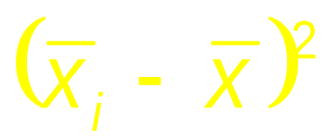
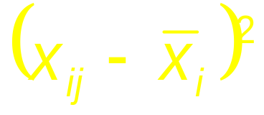
How ANOVA works (outline)
ANOVA measures two sources of variation in the data and compares their relative sizes
  variation BETWEEN groups
    for each data value look at the difference between its group mean and the overall mean
  variation WITHIN groups
    for each data value we look at the difference between that value and the mean of its group

Slide 29
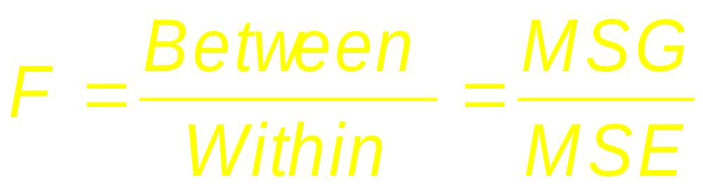
The ANOVA F-statistic is a ratio of the Between Group Variation divided by the Within Group Variation:
A large F is evidence against H₀, since it indicates that there is more difference between groups than within groups.

Slide 30
ANOVA Output
Analysis of Variance for days
Source DF SS MS F P
treatment 2 34.74 17.37 6.45 0.006
Error 22 59.26 2.69
Total 24 94.00
Df Sum Sq Mean Sq F value Pr(>F)
treatment 2 34.7 17.4 6.45 0.0063 **
Residuals 22 59.3 2.7
R ANOVA Output

Slide 31
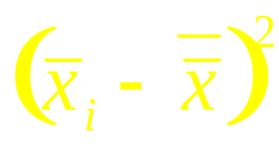
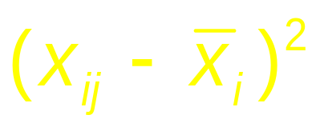
How are these computations made?
We want to measure the amount of variation due to BETWEEN group variation and WITHIN group variation
For each data value, we calculate its contribution to:
  BETWEEN group variation:
  WITHIN group variation:

Slide 32
Exercise: SPSS tutorial (Watch YouTube videos)
One Way ANOVA
https://www.youtube.com/watch?v=jYn5Jv7Gh4s
https://www.youtube.com/watch?v=il__Q5njlW0
How to Use SPSS: One Way ANOVA with Post-Hoc Tests:
https://www.youtube.com/watch?v=ehOWuOcyejI
The End

